Slide 1
01
Introduction

Slide 2
1. INTRODUCTION
Smart technology utilized to predict diseases remotely.
Health neglect due to extensive internet use highlighted as a concern.
Solution: Develop a disease prediction system using Machine Learning (ML).

Slide 3
1. INTRODUCTION... Contd.
This Web App is developed using Python’s Streamlit library. The models used to predict the diseases were trained on large Datasets.
The web-app can predict following Diseases:
Diabetes
Heart Disease
Parkinson Disease
Breast Cancer Disease
Pneumonia Disease
Alzheimer Disease

Slide 4
02
Motivation

Slide 5
2. MOTIVATION
Tech Demand:
Our project addresses the contemporary need for smart solutions by utilizing advanced technology to predict diseases.
Health Awareness:
Leveraging technology to combat the tendency for individuals to prioritize internet activities over health concerns, thereby promoting health awareness.

Slide 6
2.MOTIVATION…Contd.
Early Problem Detection:
Focusing on early detection through technology to prevent minor health issues from escalating into serious problems, thus improving overall health outcomes.
With the advancement in technologies and mobile phones being the most used user-friendly device, an application that provides a prediction of the most caused lifestyle diseases like diabetes, heart disease, and other diseases. Disease predictor allows you to make important predictions about an ongoing but unknown disease with a few pieces of information like symptoms and diagnostic reports. It also helps you to have an in-depth knowledge of the symptoms, causes, and other important factors for future reference.

Slide 7
03
Project Objectives

Slide 8
3. PROJECT OBJECTIVES
Improve Data Analysis:
Enhance the accuracy of medical data analysis, even when some information is missing.(Method Used – SVM, Logistic Regression)
Understand Regional Diseases:
Predict diseases more effectively by recognizing variations in diseases across different regions.(Heart, Pneumonia, Diabetes, Breast Cancer, Parkinson, Alzheimer)
Handle Various Data Types:
Address the limitation of current methods that primarily handle organized data.(Numerical data)
Include less organized data types, such as semi-structured and unstructured data.

Slide 9
3. PROJECT OBJECTES…Contd.
Develop Effective Data Handling Methods:
Create techniques to handle different data types, particularly semi-structured and unstructured data.(Normalization, Resampling, Data Augmentation)
Conduct Comprehensive Data Analysis:
Consider both organized and less organized data for a more thorough analysis.
Enhance Accuracy with Machine Learning:
Utilize machine learning algorithms to improve the precision of disease analysis and predictive models.

Slide 10
04
Methodology/Block Schematic of Project

Slide 11
4. Methodology/Block Schematic of Project
Procedure : • Import the necessary libraries and the datasets • Split the data into features and target variables • Split the data into training and testing sets • Train the model on the training data • Save the model using the pickle module • Use Streamlit to create a web application that allows users to input their own data and make predictions using the saved model • Include a button in the application to process the user input and make predictions

Slide 12
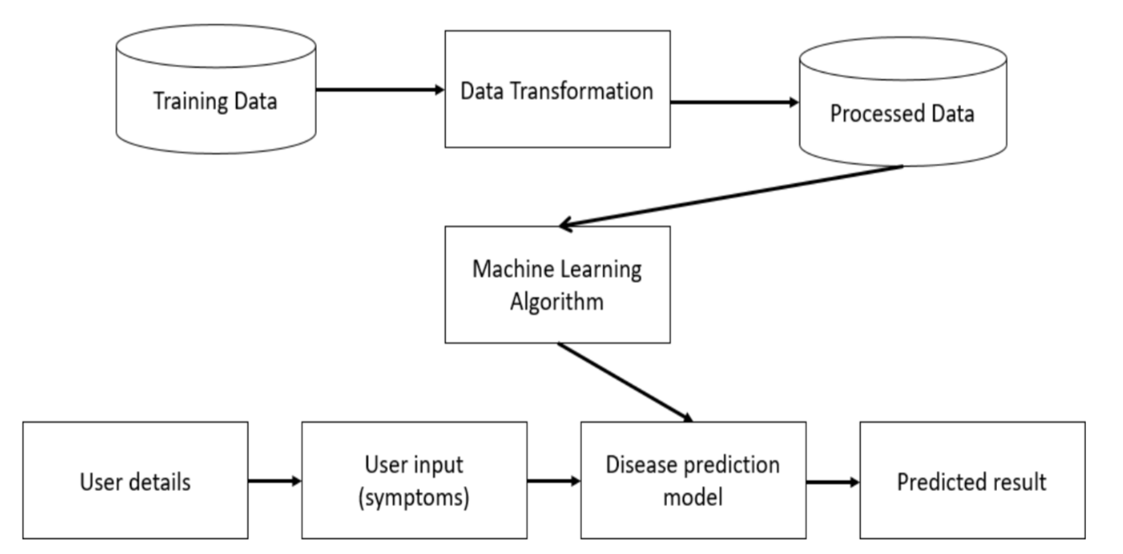
4. Methodology/Block Schematic of Project
Fig.No.-1 Block Diagram

Slide 13
05
Literature Review/
Currently available
solutions

Slide 14
5. LITERATURE REVIEW/CURRENTLY AVAILABLE SOLUTIONS
Year | Author | Purpose | Accuracy
2019 | Dr. Anjan Nikhil | Designed and implemented a prediction model for heart disease using naive Bayesian | 89.7%
2018 | Dr. Aakash Chauhaun | Proposed a disease prediction model for heart disease by utilizing evolutionary rule learning | 53%
2018 | Mr. Aditi Gavha | Suggested prediction for heart disease that utilizes Machine Learning using KNN | 91%
2017 | Dr. Rashmi G Saboji | Tried to find a scalable solution that can predict heart disease utilizing classification mining | 95%

Slide 15
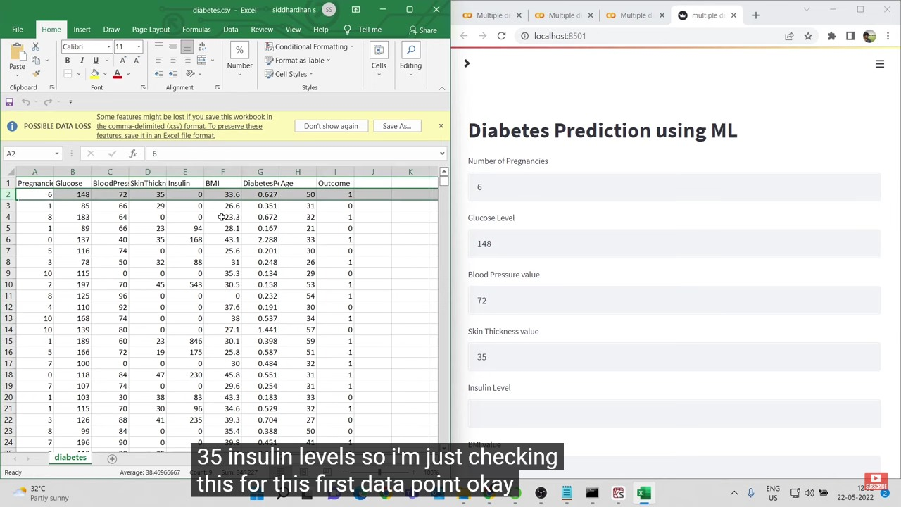
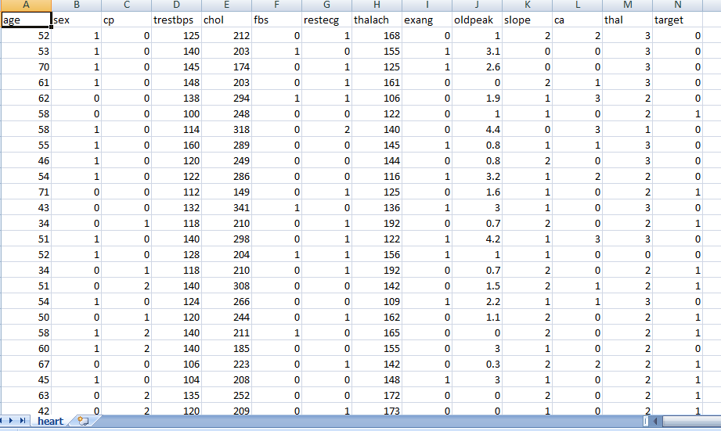
5. LITERATURE REVIEW/DATASET SAMPLE
Bmi –Body Mass Index
Age-year
Skin thickness-mm
Blood Pressure-mmHg(1Torr)
Chol- Cholesterol level
Fbs- Fasting Blood Sugar
Cp- constrictive pericarditis
Trestbps- Person Resting blood Pressure
Fig. No. -2 (Diabetes Dataset)(Reference- Kaggle)
Fig.No.-3 (Heart Dataset) (Reference- Kaggle)

Slide 16
06
Algorithms used

Slide 17
6. Algorithms used
1) SVM – Support Vector Machine : Support Vector Machine or SVM is one of the most popular Supervised Learning algorithms, which is used for Classification as well as Regression problems. The goal of the SVM algorithm is to create the best line or decision boundary that can segregate n-dimensional space into classes so that we can easily put the new data point in the correct category in the future. 2) Logistic Regression : Logistic regression is one of the most popular Machine Learning algorithms, which comes under the Supervised Learning technique. It is used for predicting the categorical dependent variable using a given set of independent variables. Logistic Regression is a significant machine learning algorithm because it has the ability to provide probabilities and classify new data using continuous and discrete datasets.

Slide 18
07
Implementation

Slide 19
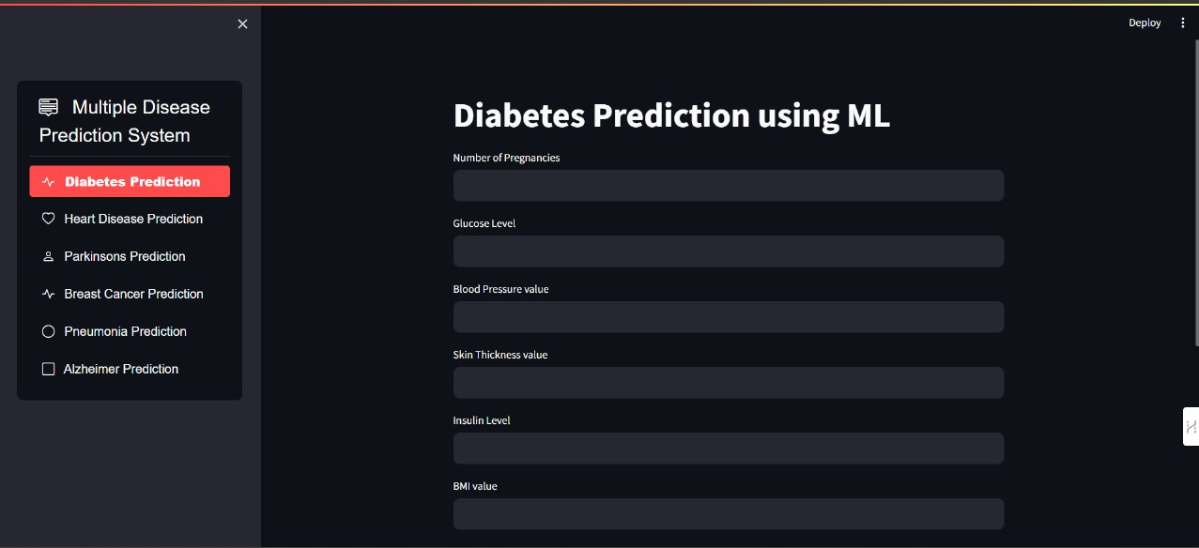
7. Implementation
Fig. No. -4 Implementation Sample

Slide 20
08
Work Progress and Demonstration

Slide 21
8. WORK PROGRESS AND DEMONSTRATION
Week | Expected Milestones | Completed | Tobecompleted
1. | Find real world problem | ✓ | ✘
2. | Deciding Project | ✓ | ✘
3. | Basic Python Programming | ✓ | ✘
4. | Data Collection | ✓ | ✘
5. | Neural Networks Training | ✓ | ✘
6. | Machine Learning Algorithm | ✓ | ✘
7. | Feature Selection | ✓ | ✘

Slide 22
8. WORK PROGRESS AND DEMONSTRATION
Week | Expected Milestones | Completed | Tobecompleted
8. | Pre-processing of data set | ✓ | ✘
9. | Training of machine learning model | ✓ | ✘
10. | Training of machine learning model | ✓ | ✘
11. | Training of machine learning model | ✓ | ✘
12. | Testing of machine learning model | ✓ | ✘
13. | Integration of machine learning model with the app | ✓ | ✘
14. | Developing the application | ✓ | ✘
15. | Testing of the application | ✓ | ✘

Slide 23
Thanks! Questions and Answers

